Slide 1
Neural networks in image saliency prediction
Magdalena Rajtor

Slide 2
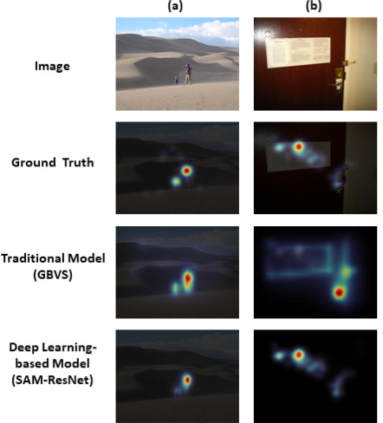
Overview of image saliency
saliency - unique features of a processed image saliency map - their topographical representation
more than just object detection
modelling approaches:
Graph-Based Visual Saliency (GBVS)
Contextual Guidance Model
CNNs, RNNs, GANs
CNN+ (e.g. SAM-ResNet)
CNN++ (e.g. TranSalNet)
Lou, J., Lin, H., Marshall, D., Saupe, D. & Liu, H. (2022). TranSalNet: Towards perceptually relevant visual saliency prediction,
Neurocomputing, 494, 455-467, https://doi.org/10.1016/j.neucom.2022.04.080

Slide 3
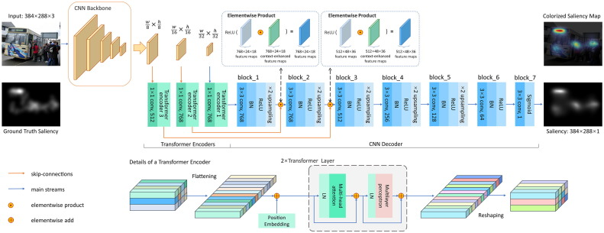
Challenges with modelling saliency
they should have semantics (understanding image content)
task and context dependance
emotional factors
datasets: CAT2000 (sample of 400 images), EMOd (~700), paintings (150)
TranSalNet_Res model SIM on CAT2000: 0.75
SIM (Similarity Index) vs SSIM (Structural Similarity Index)

Slide 4
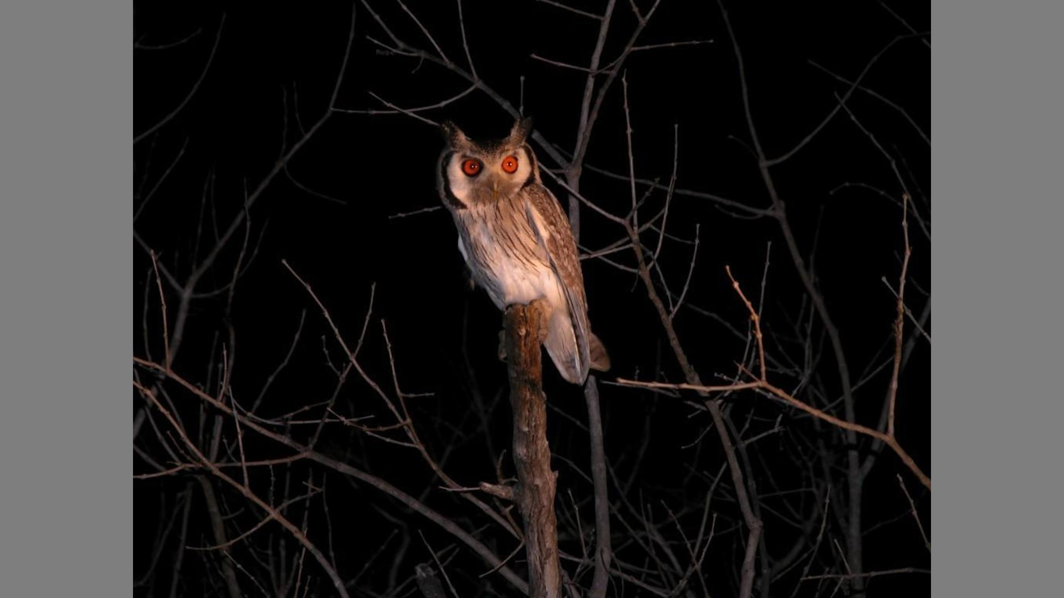
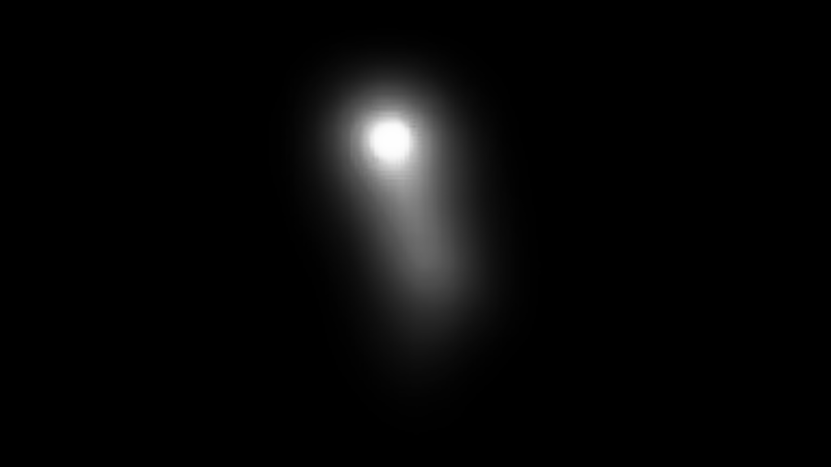

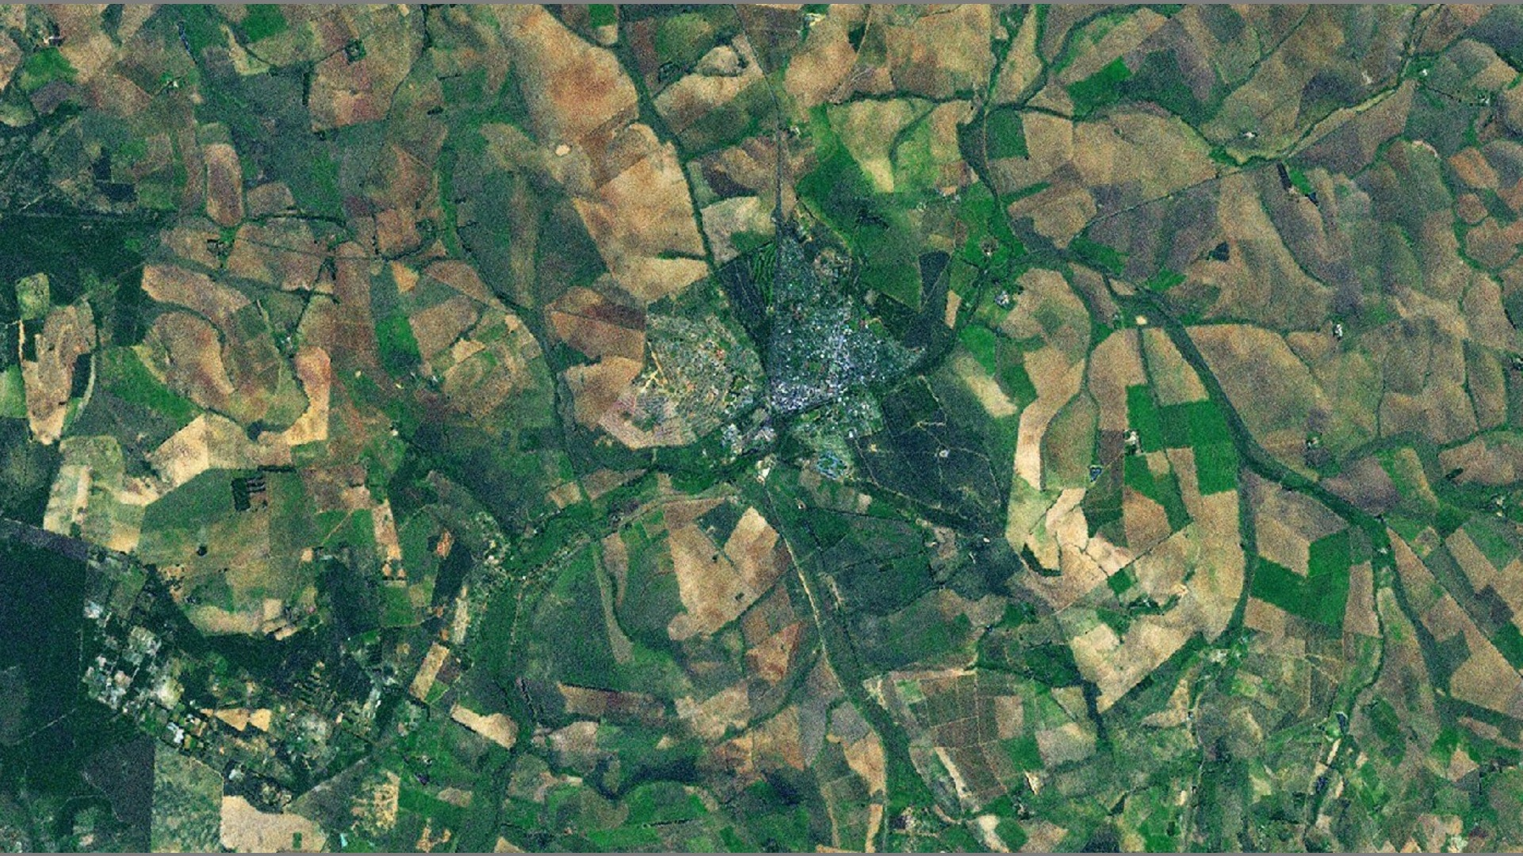
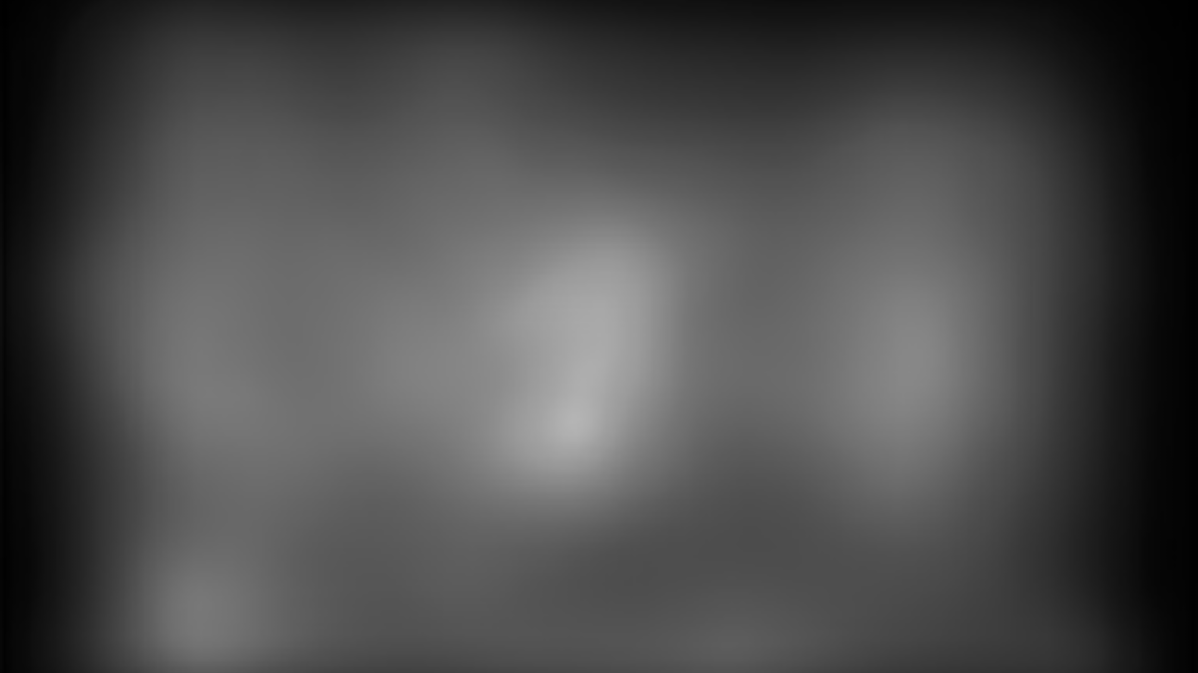
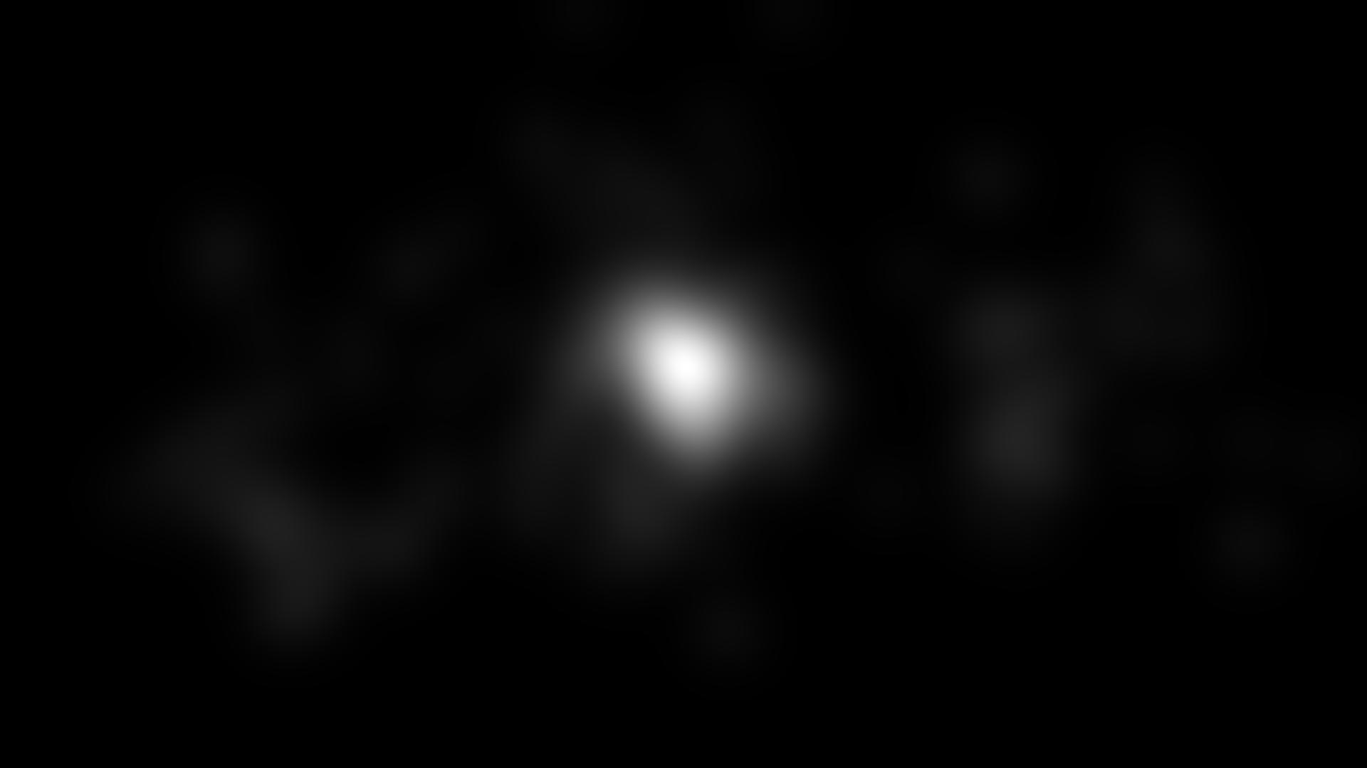
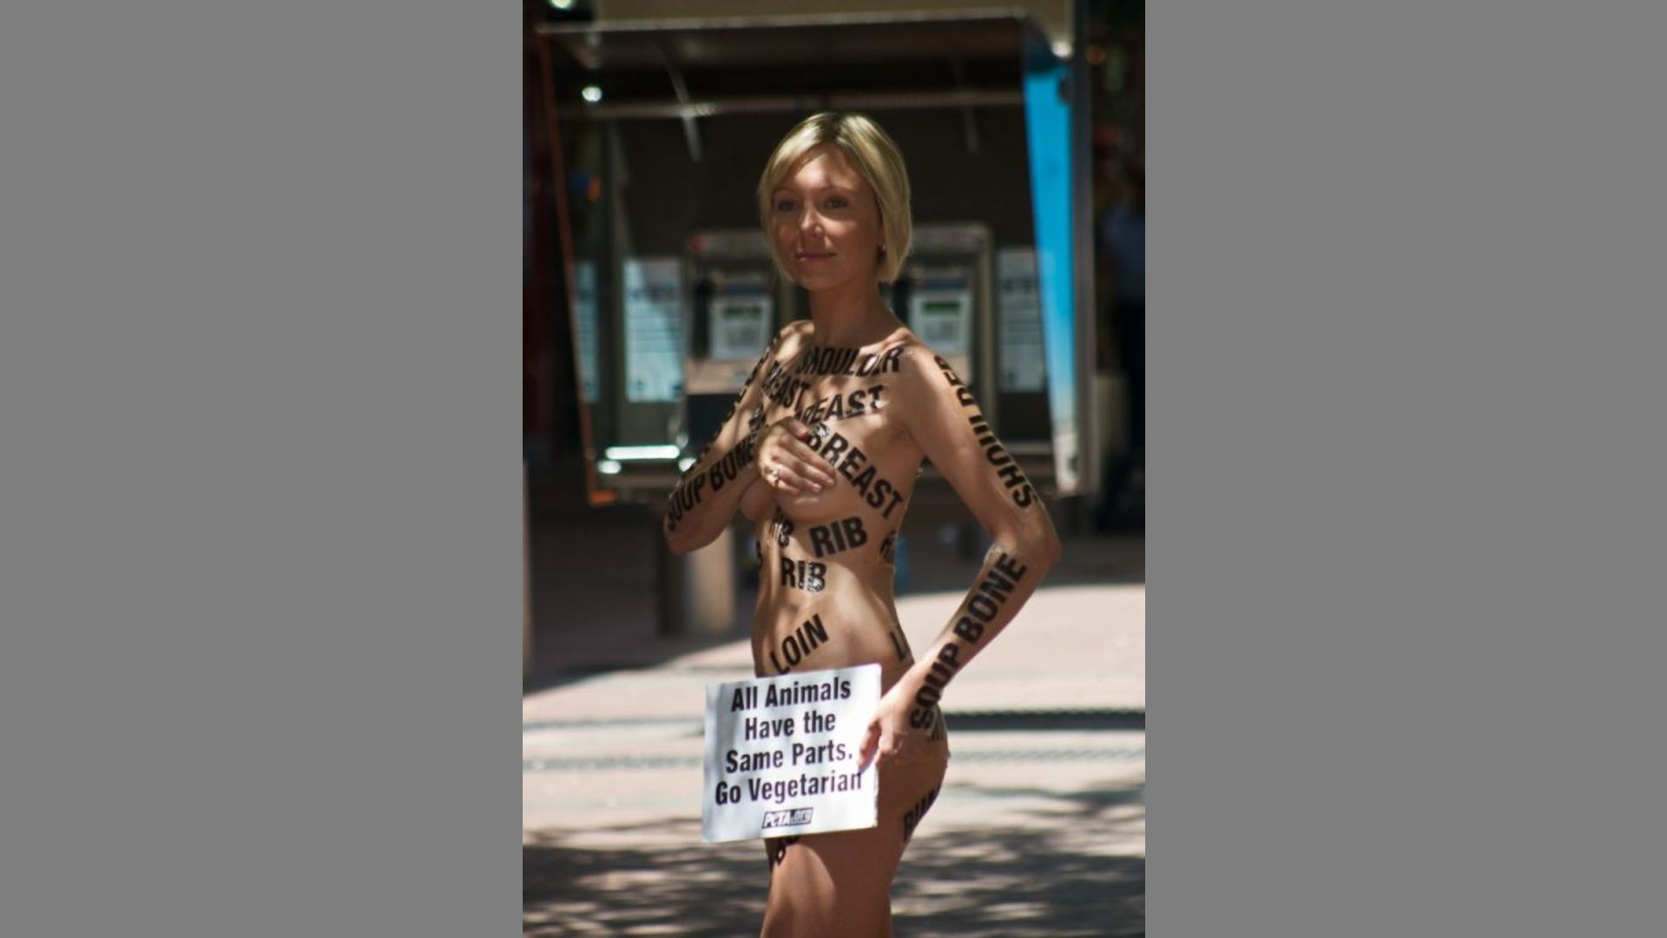
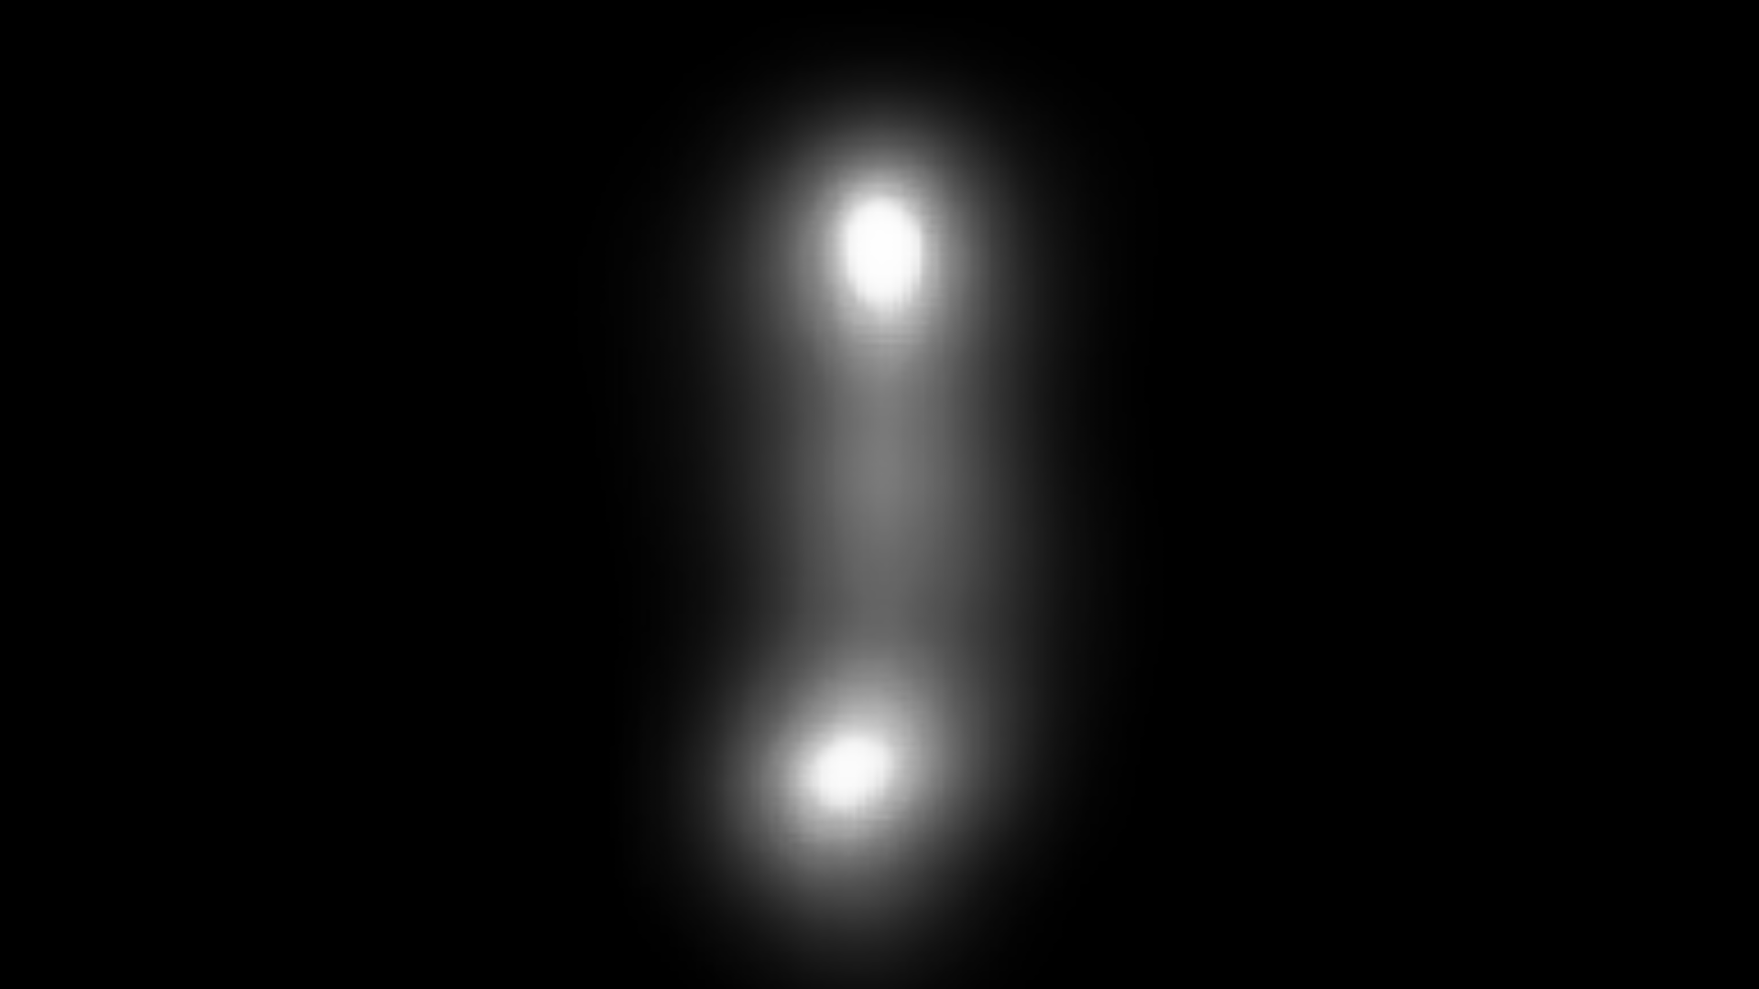
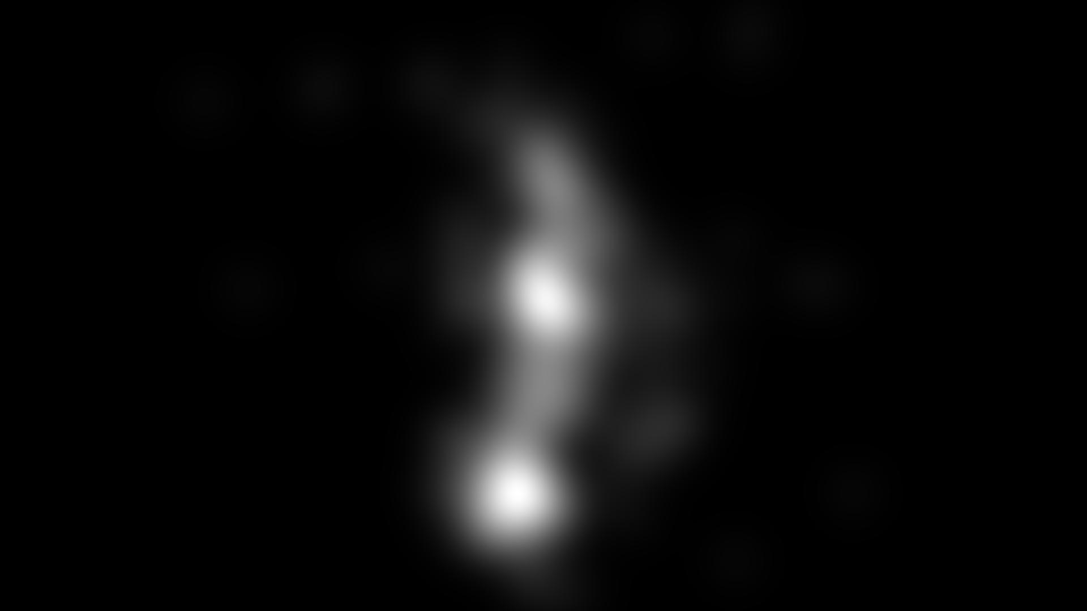
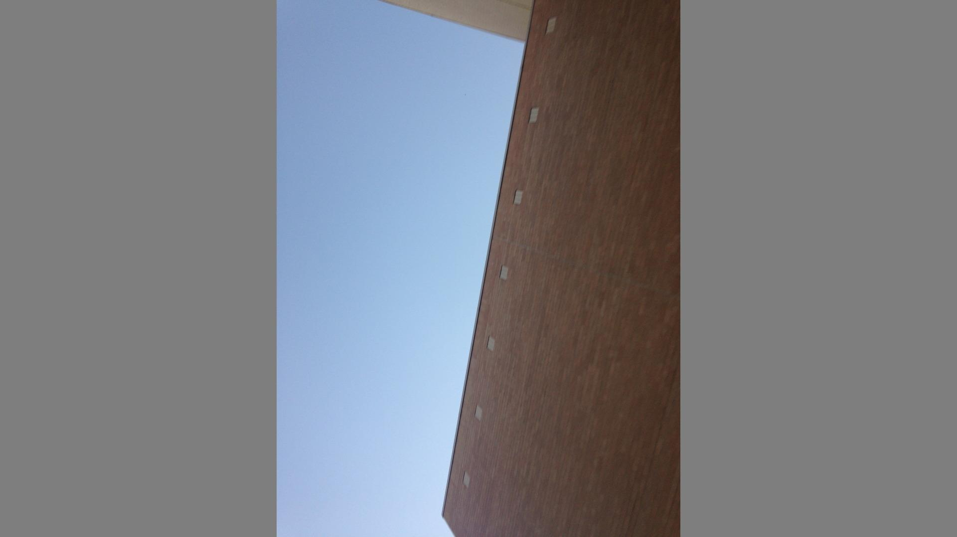
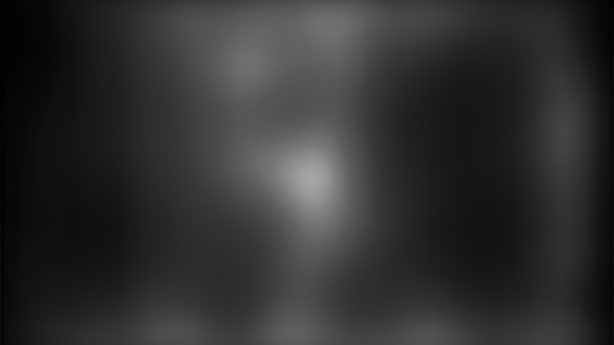
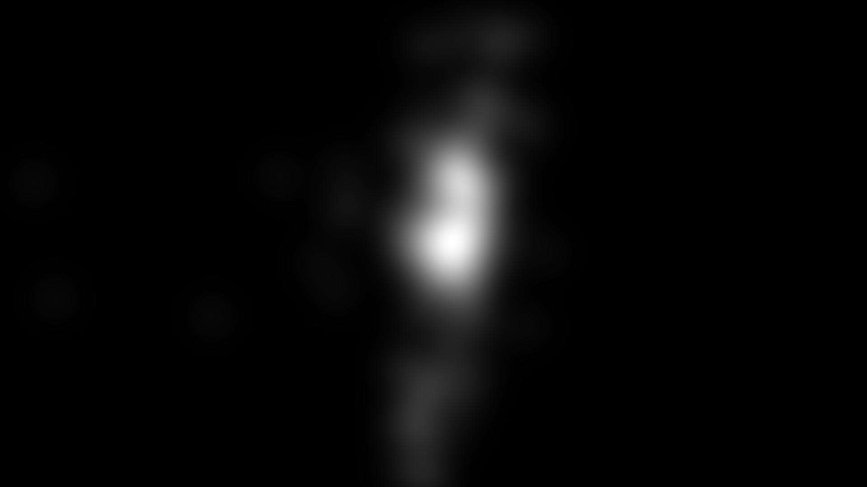
Baseline performance - CAT2000
CAT2000 | 0.47
ART | 0.48
EMO | 0.57
mean SSIM scores
BEST (0.89) | WORST (0.12)

Slide 5
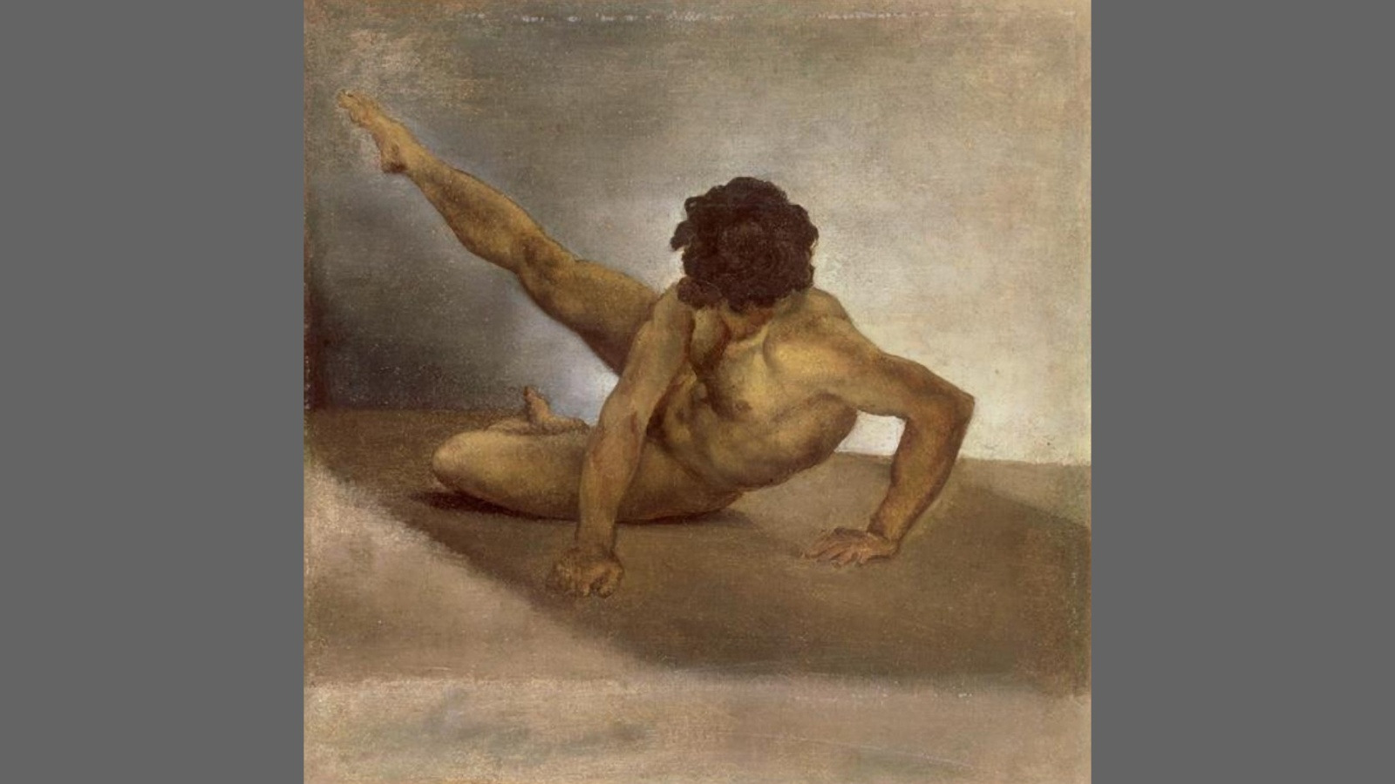
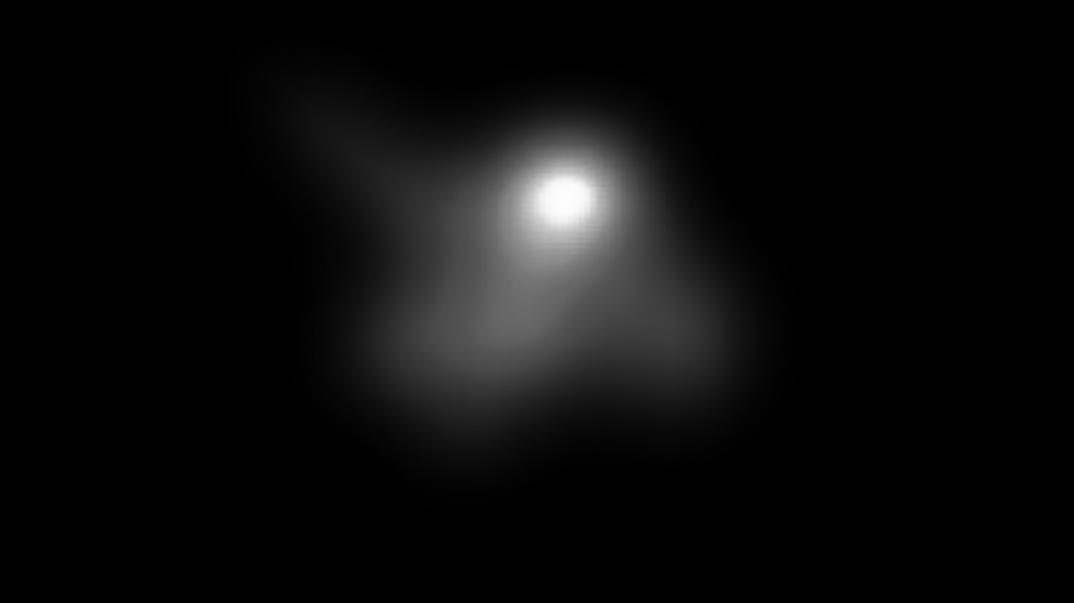

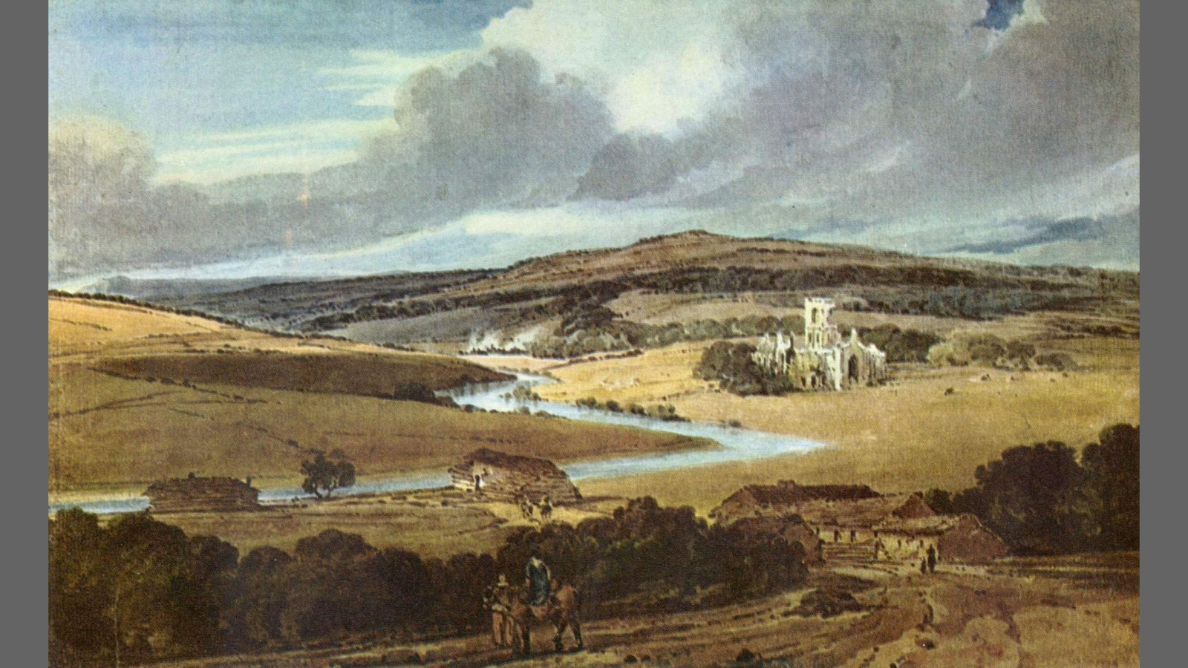
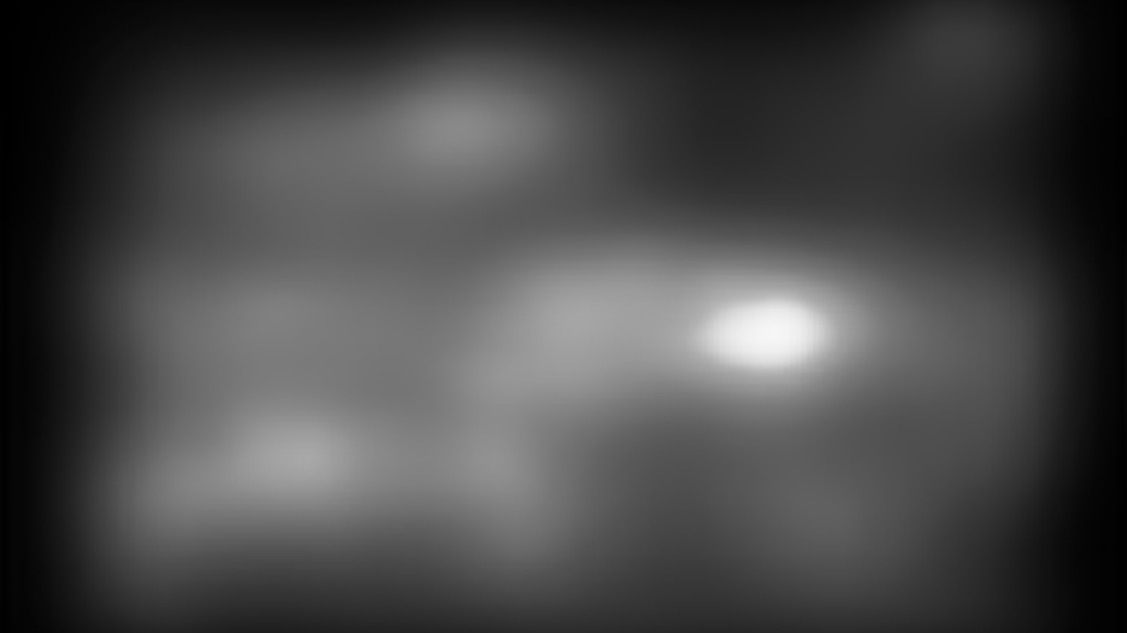

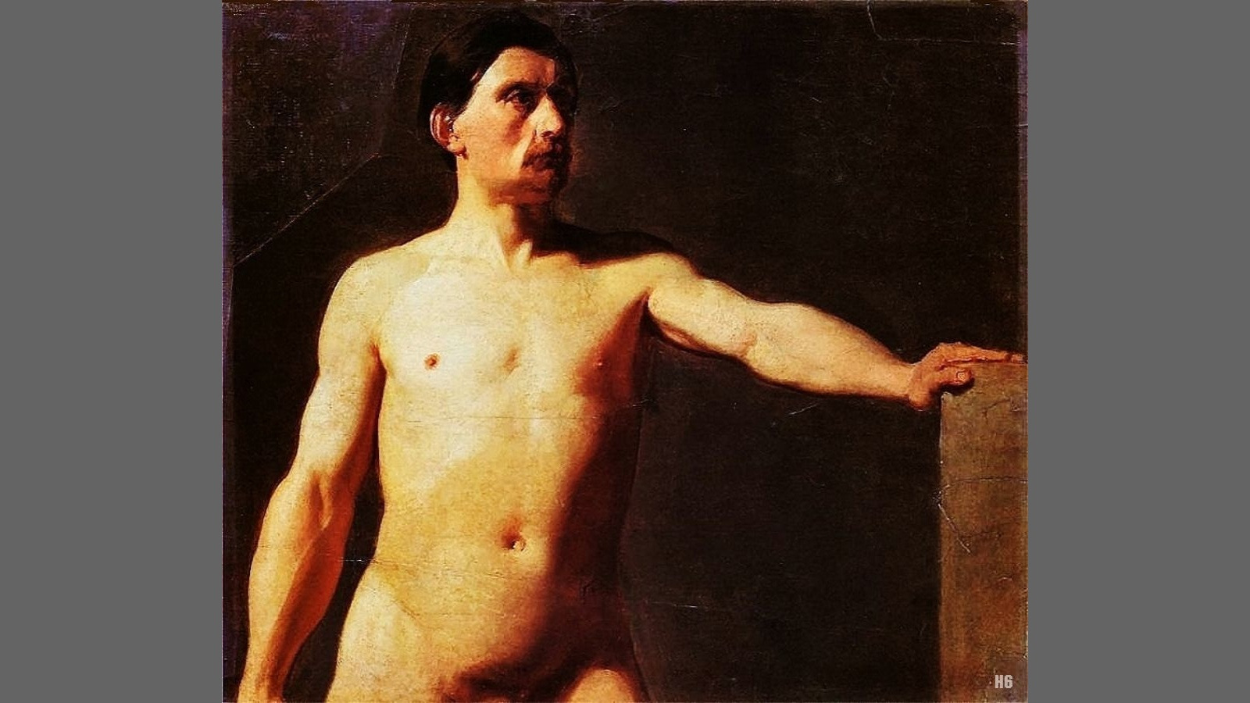


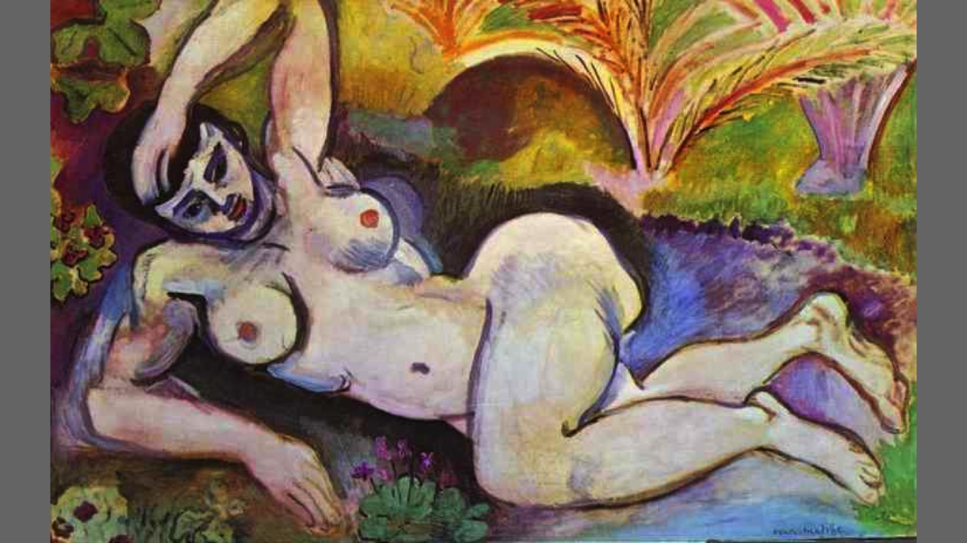
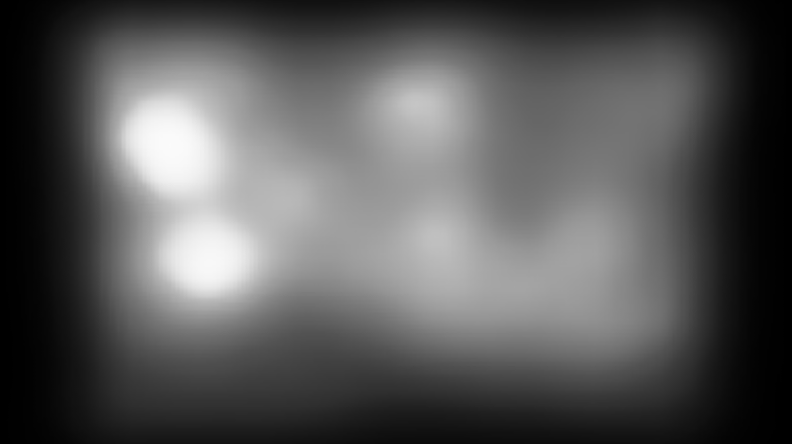

Baseline performance - ART
CAT2000 | 0.47
ART | 0.48
EMO | 0.57
mean SSIM scores
BEST (0.85) | WORST (0.13)

Slide 6
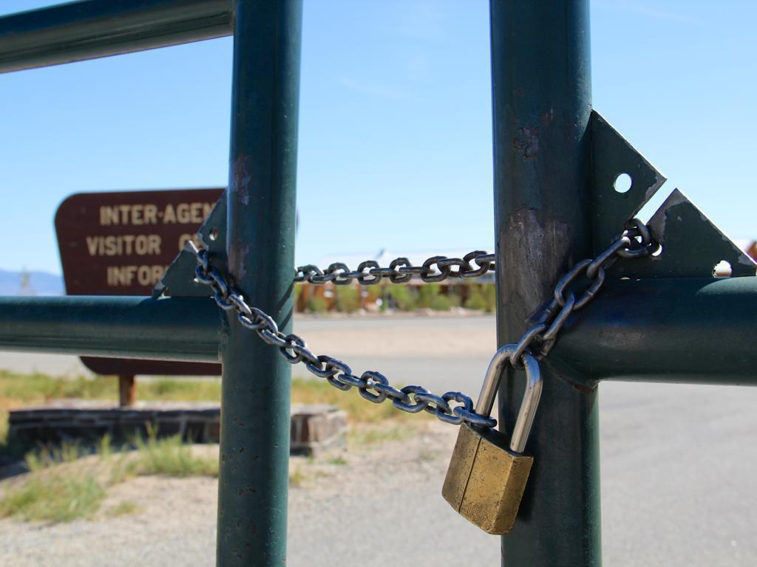

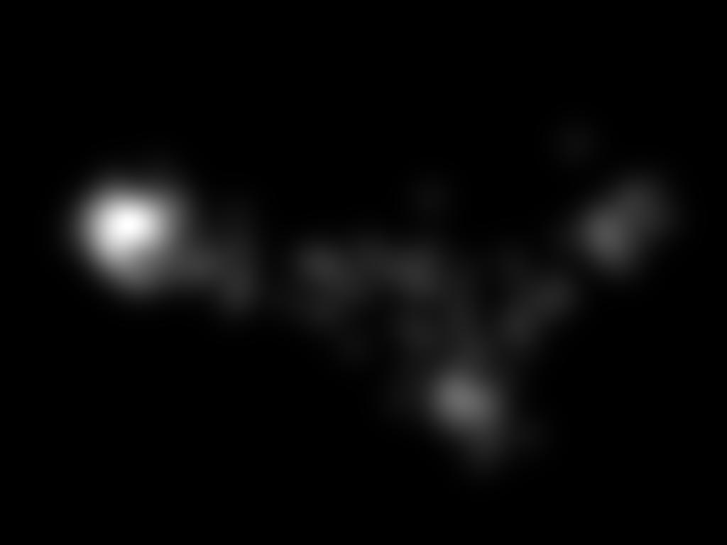

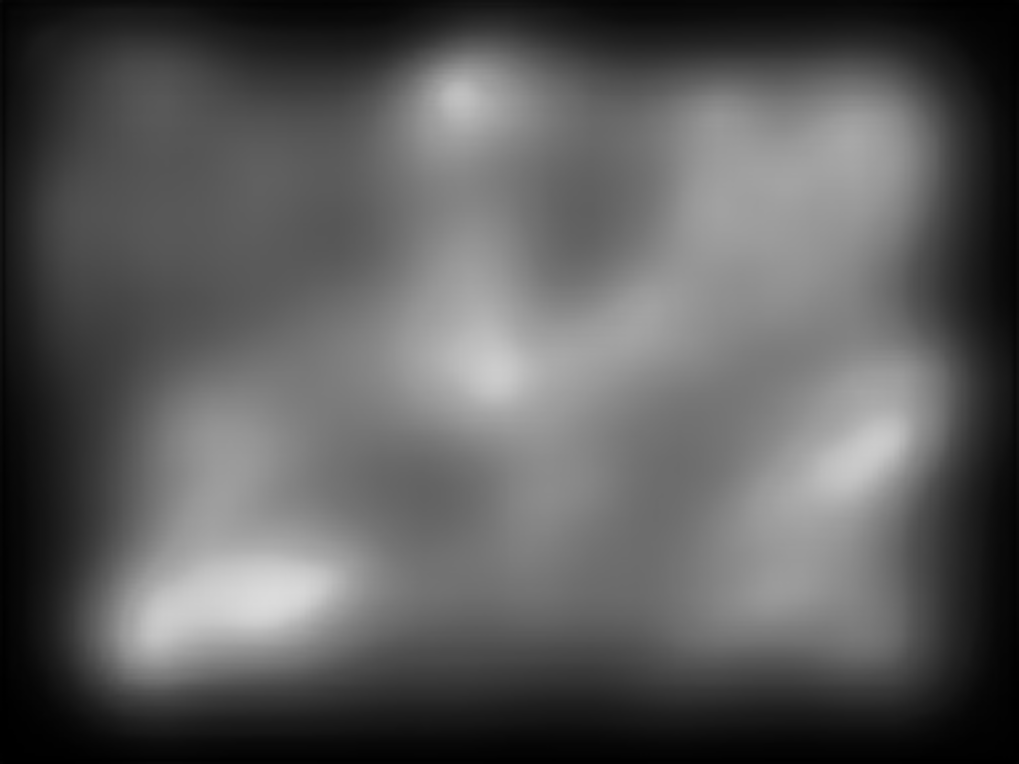
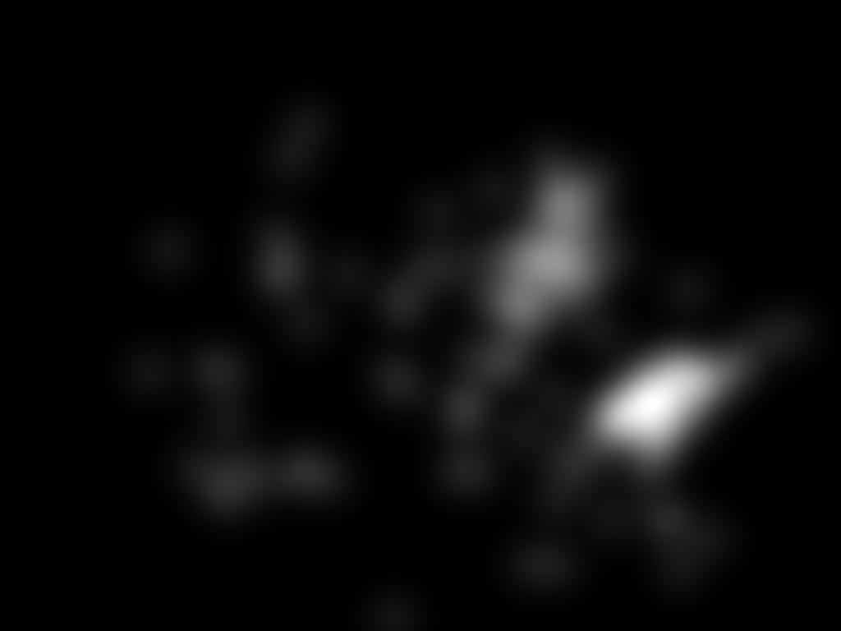
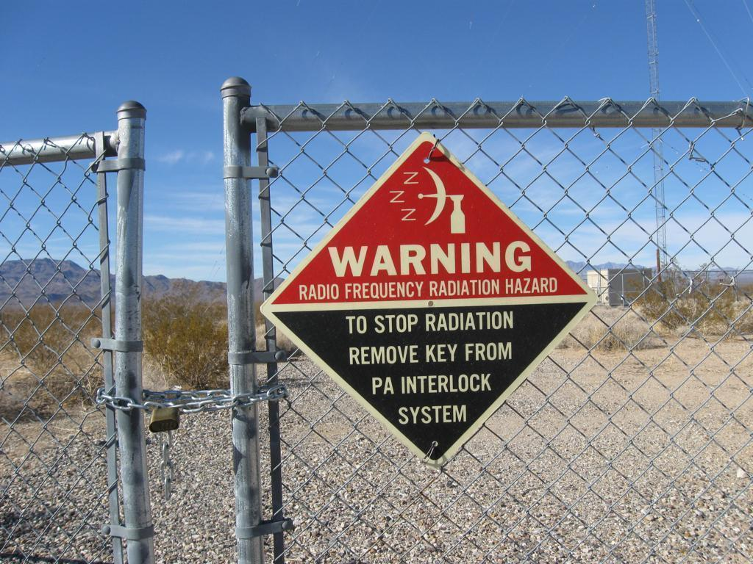

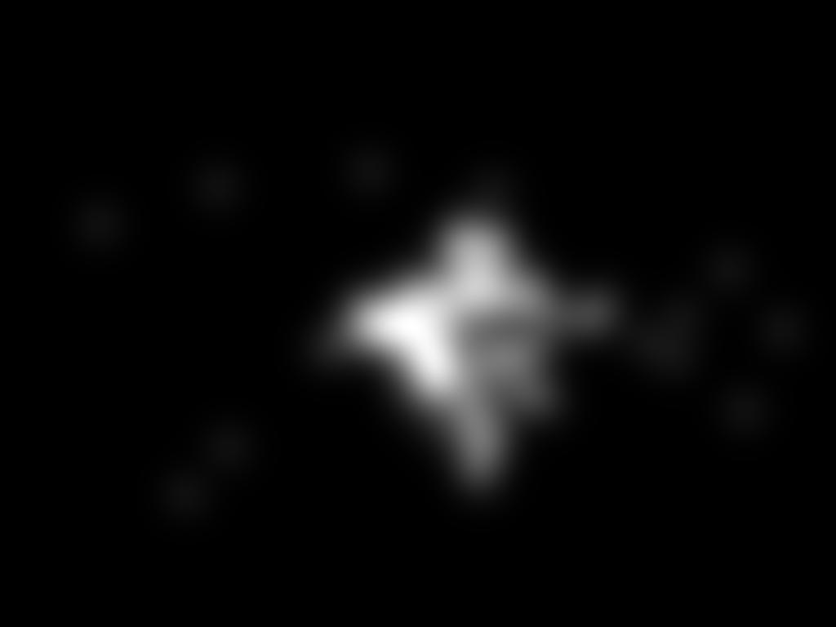
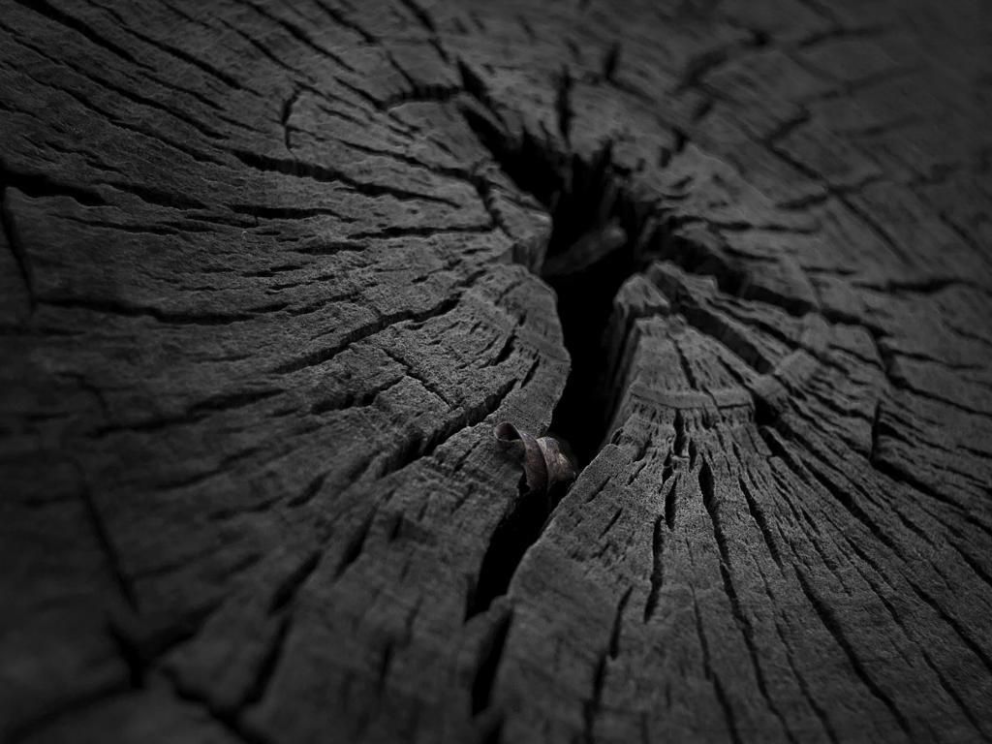
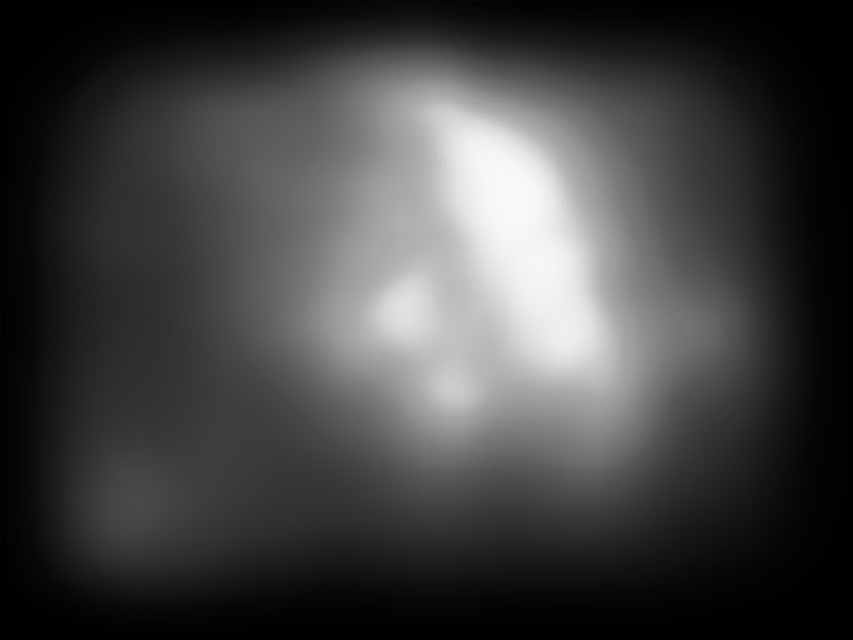
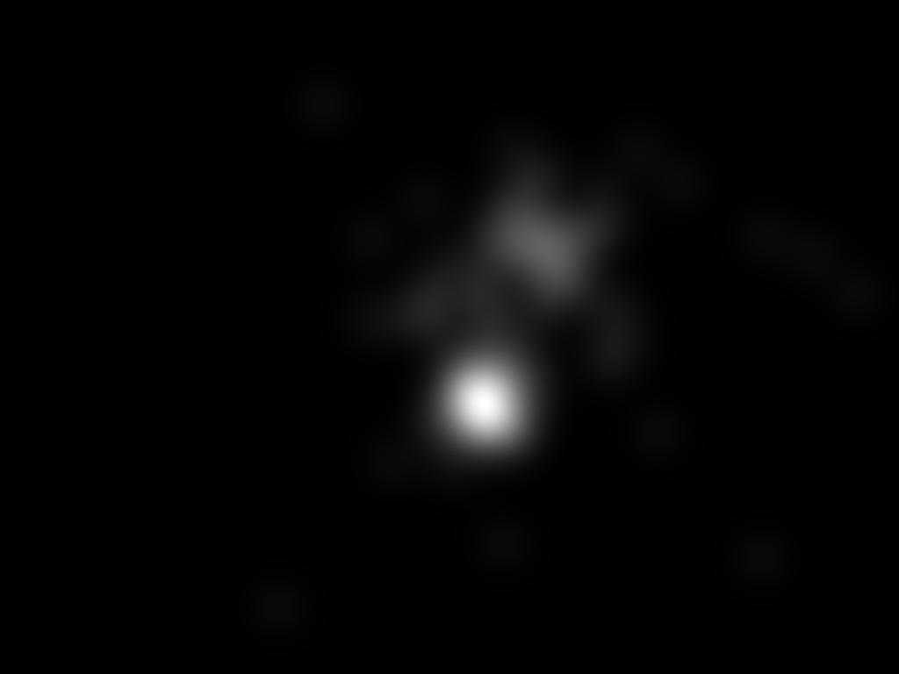
Baseline performance - EMO
CAT2000 | 0.47
ART | 0.48
EMO | 0.57
mean SSIM scores
BEST (0.87) | WORST (0.15)

Slide 7
ART dataset 70% train 15% val 15%test EMO dataset 70% train 15% val 15%test
base model model finetuned on ART model finetuned on EMO

Slide 8
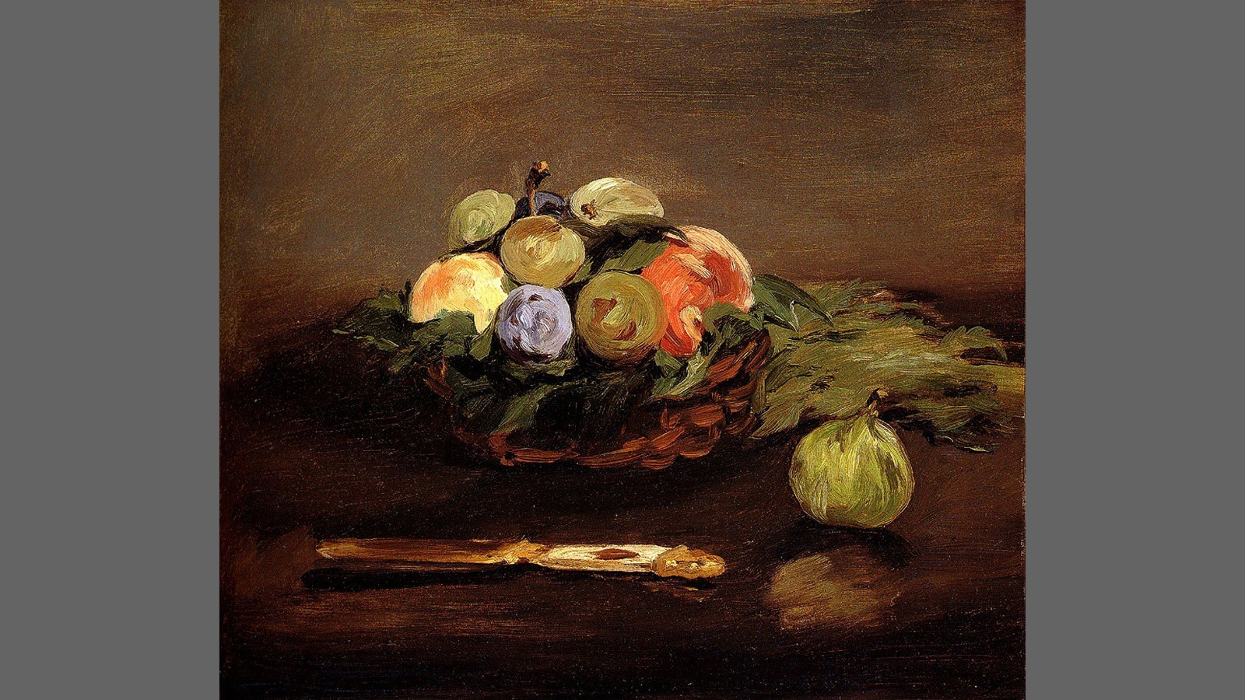
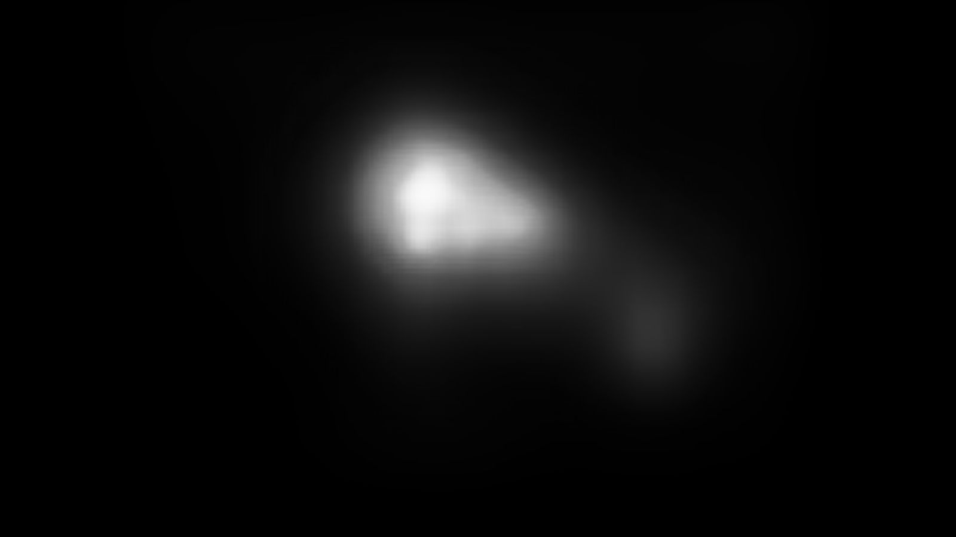

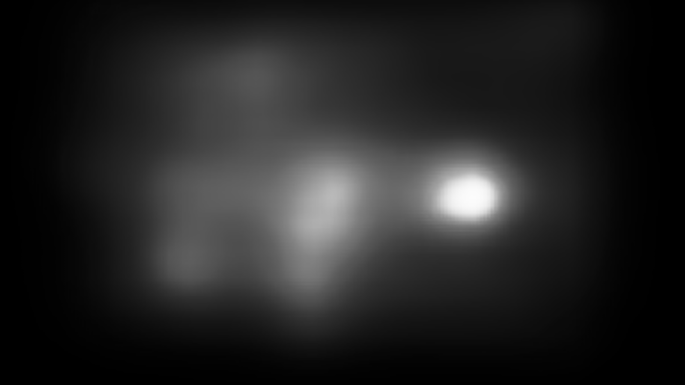
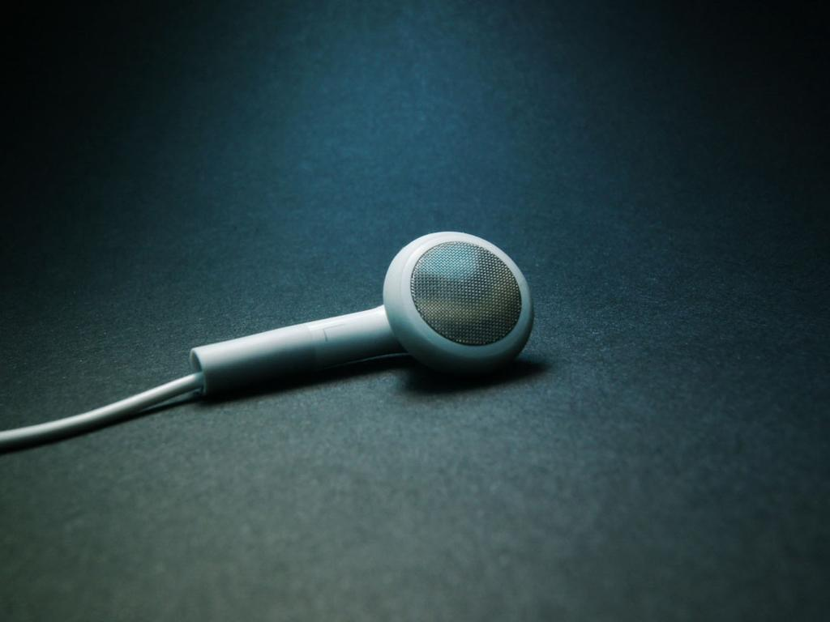

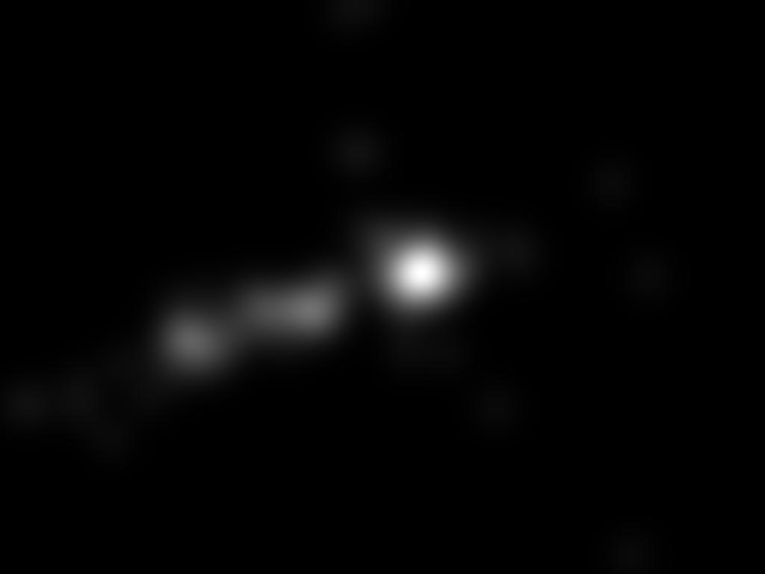


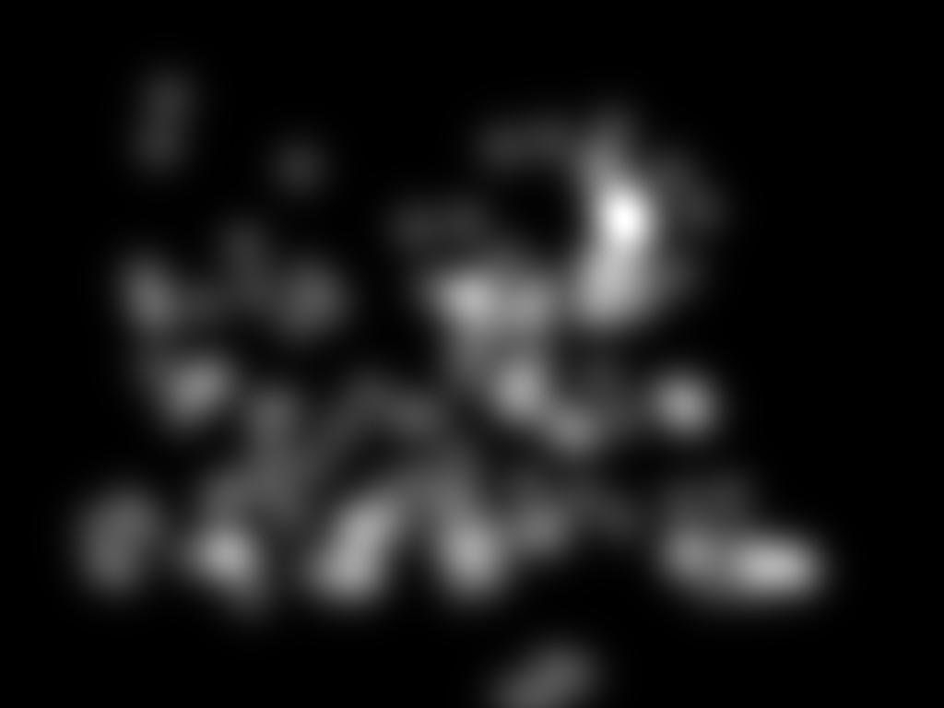
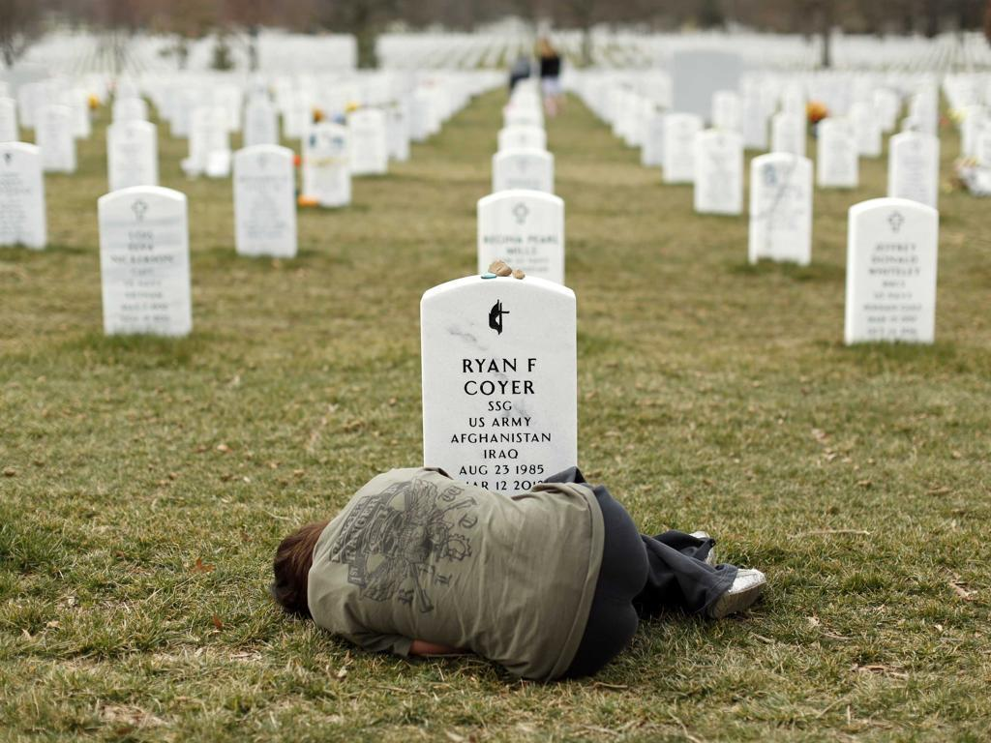

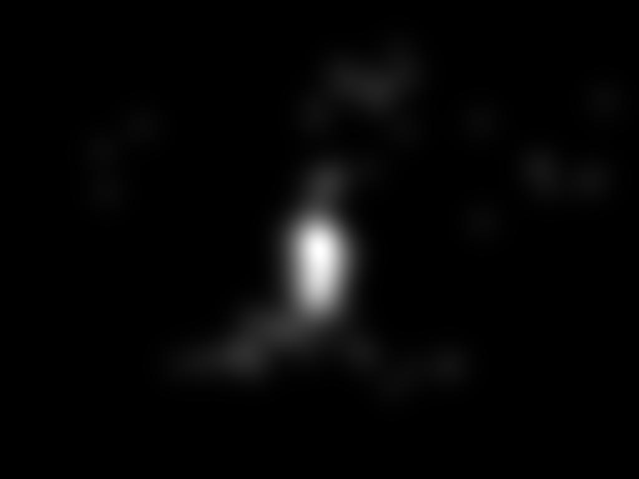

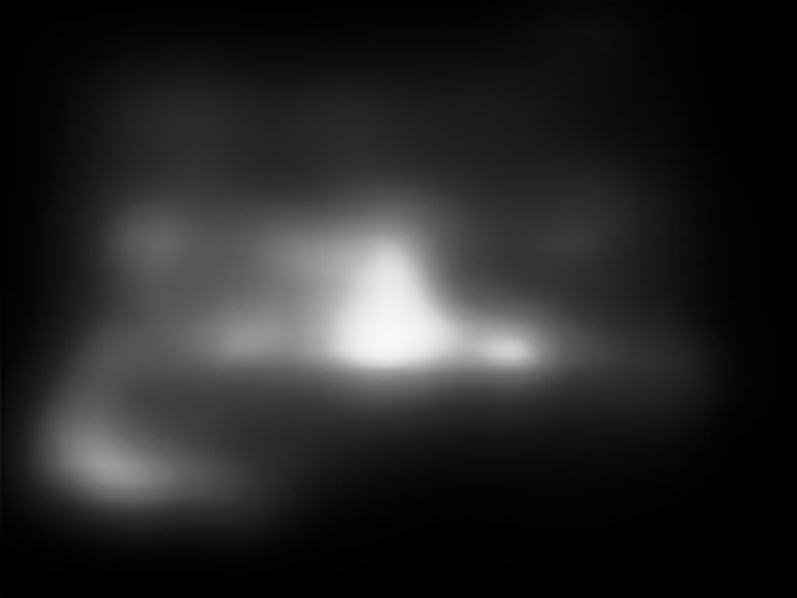
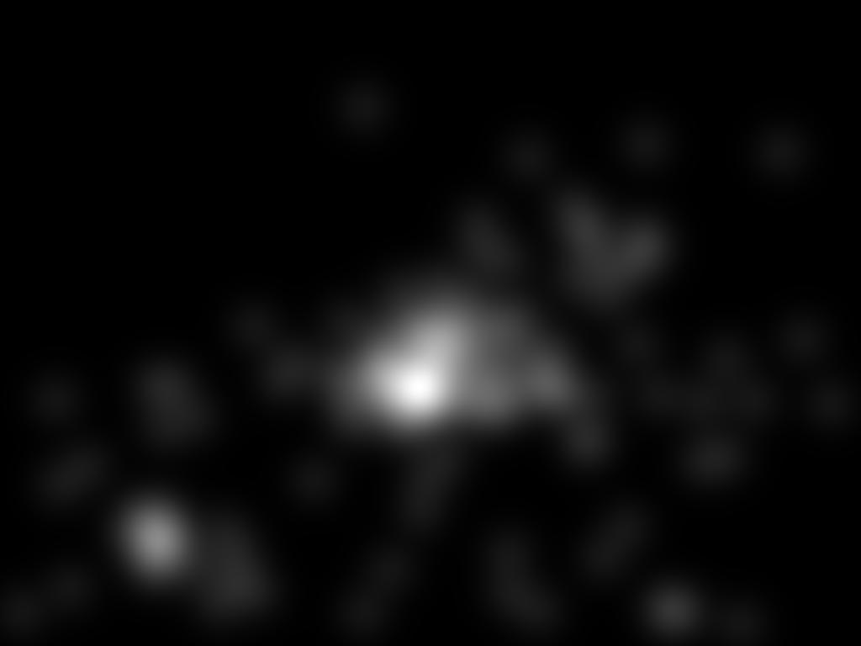
2) Finetuning on ART
BEST | WORST
best: 0.83
worst: 0.13
best: 0.77
worst: 0.34
best: 0.83
worst: 0.31
best: 0.75
worst: 0.41
ART base 0.49
ART 0.59
EMO base 0.57
EMO 0.59

Slide 9
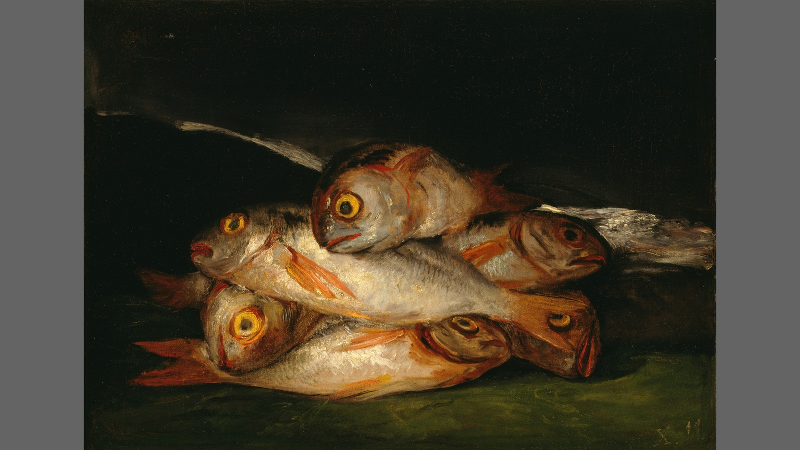





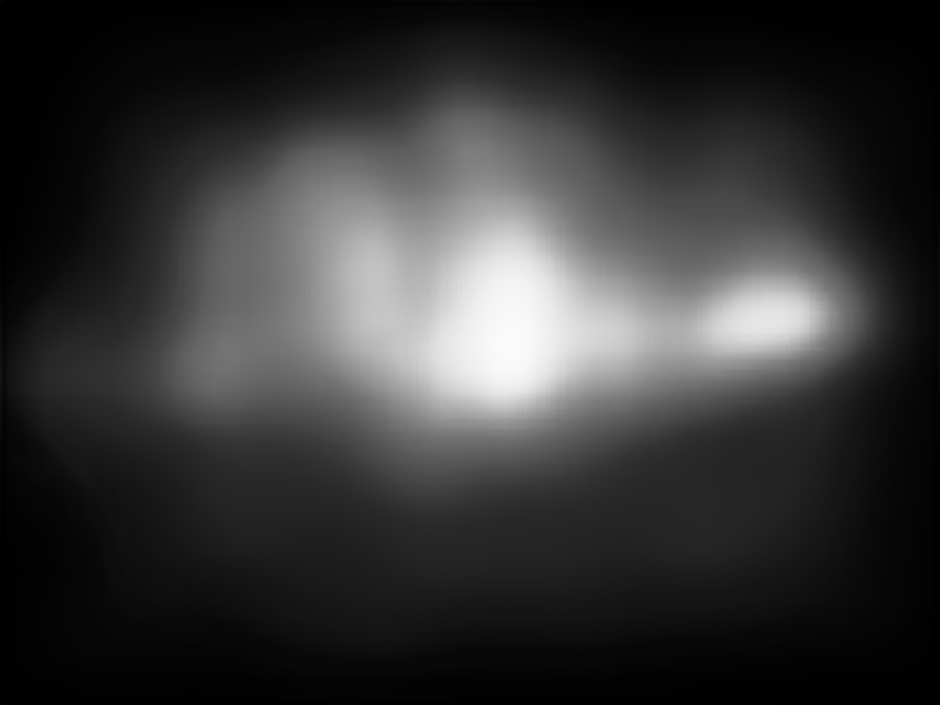
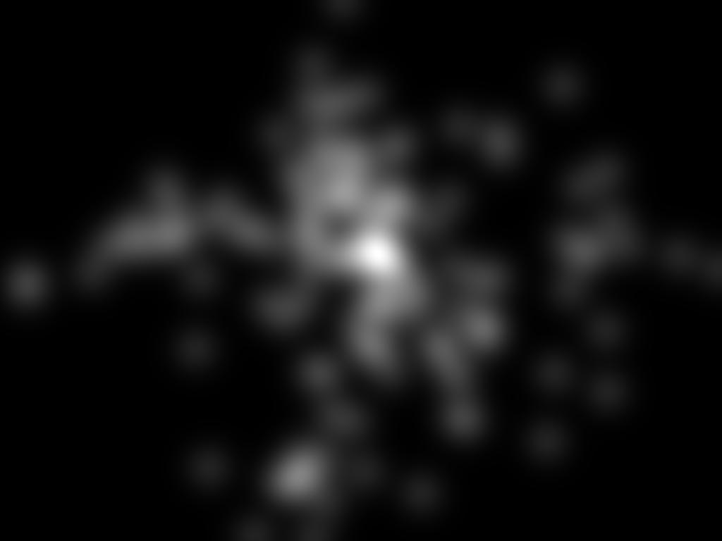
3) Finetuning on EMO
BEST | WORST
best: 0.83
worst: 0.13
best: 0.77
worst: 0.34
best: 0.83
worst: 0.31
best: 0.86
worst: 0.41
ART base 0.49
ART 0.59
EMO base 0.57
EMO 0.68

Slide 10
